Slide 1

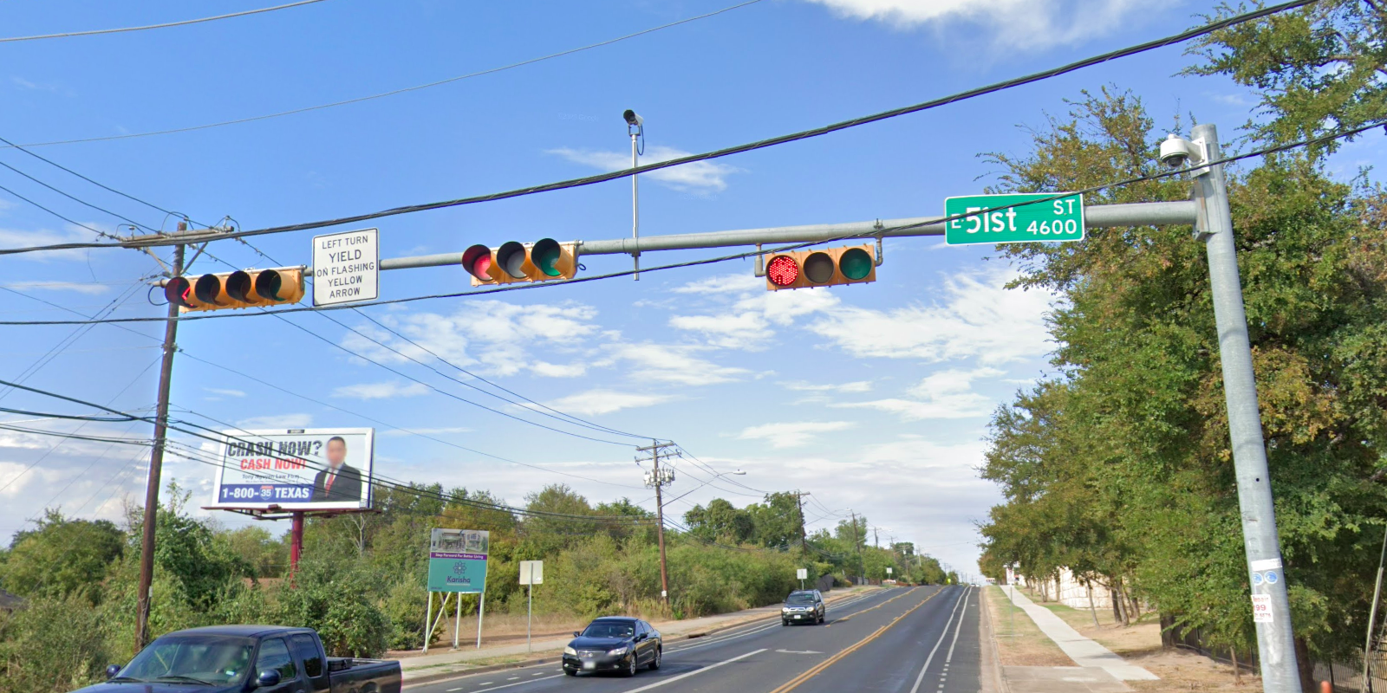
Austin Transportation Department Signs Work Orders
Created By: Susanne Gov Created Date: 2020-08-10 Location Name: SPRINGDALE RD / 51ST ST Intersection ID: 5164505 Cardinal Direction: N Work Order ID: SG-20648
Sign Type | Install/Remove
Left Turn Yield Flashing Yellow | Remove
Street Name Sign | Install

Slide 2
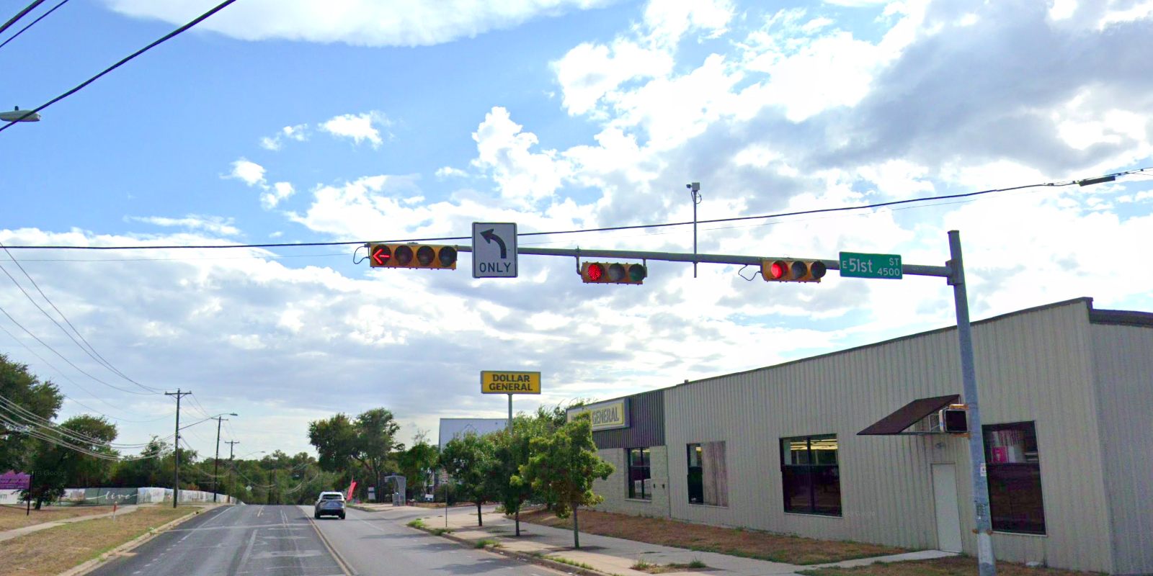
Austin Transportation Department Signs Work Orders
Created By: Susanne Gov Created Date: 2020-08-10 Location Name: SPRINGDALE RD / 51ST ST Intersection ID: 5164505 Cardinal Direction: S Work Order ID: SG-20648
Sign Type | Install/Remove
Street Name Sign | Install
Left Turn Arrow Only | Install

Slide 3
Austin Transportation Department Signs Work Orders
Created By: Susanne Gov Created Date: 2020-08-10 Location Name: SPRINGDALE RD / 51ST ST Intersection ID: 5164505 Cardinal Direction: E Work Order ID: SG-20648
Sign Type | Install/Remove
Left Turn Yield Flashing Yellow | Remove
Street Name Sign | Install

Slide 4
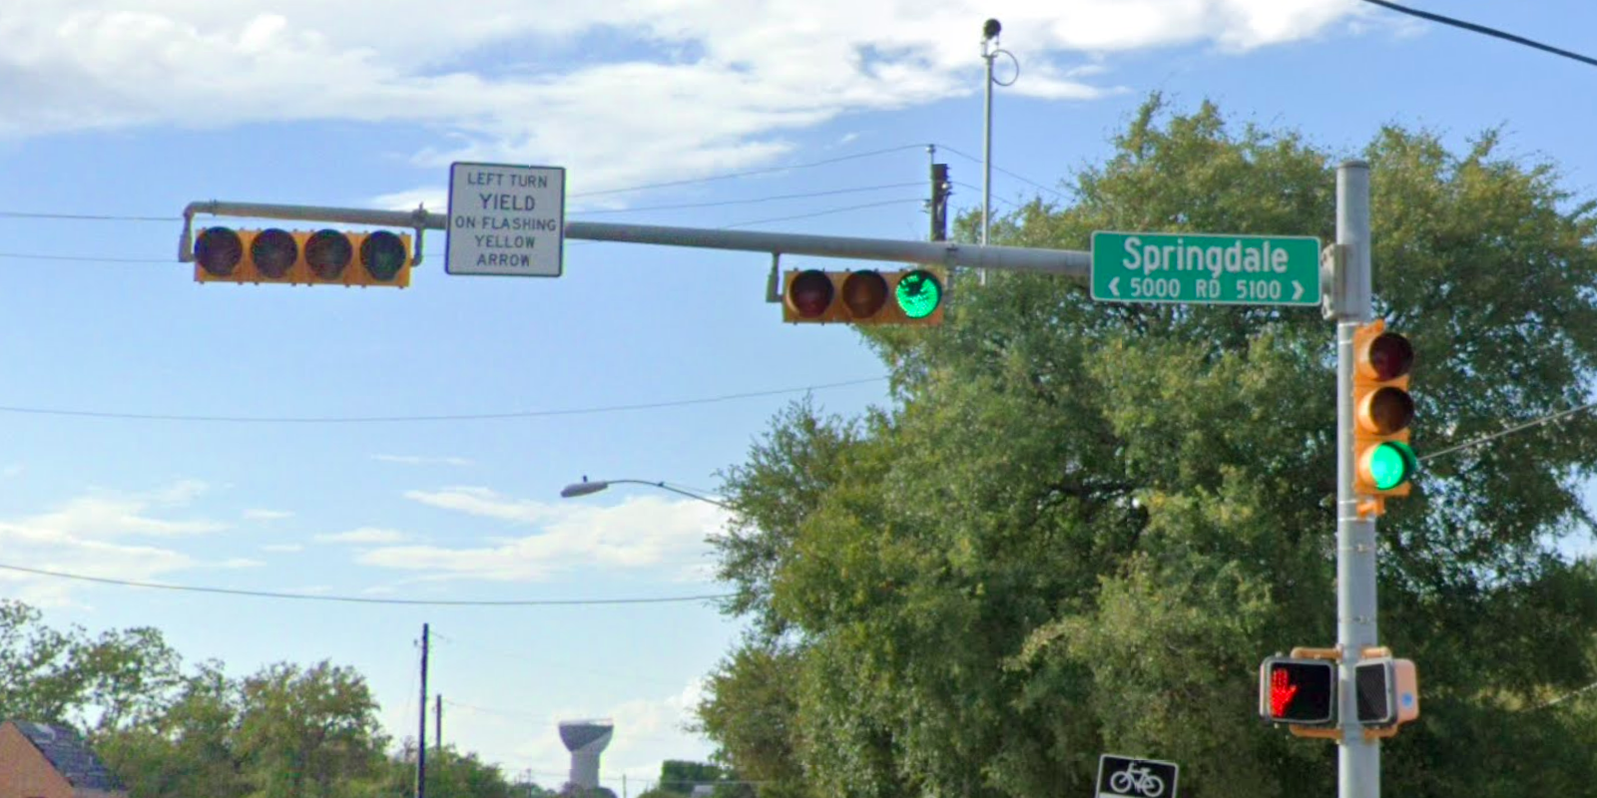
Austin Transportation Department Signs Work Orders
Created By: Susanne Gov Created Date: 2020-08-10 Location Name: SPRINGDALE RD / 51ST ST Intersection ID: 5164505 Cardinal Direction: W Work Order ID: SG-20648
Sign Type | Install/Remove
Left Turn Yield Flashing Yellow | Remove
Street Name Sign | Install

